Slide 1
Health Benefit Cards
Health benefit cards can act as prompts, similar to the prompt card, in starting a conversation with a service user and thinking about the sorts of benefits you may want to promote. Cards have been provided for:
Physical Activity
Alcohol
Mental wellbeing
Smoking
Sexual health
Health eating
You may want to tailor the information on the cards or the topic areas by adding new cards
Notes:
The information conveyed in the following slides (to slide 38) is drawn from Pharmacy Link publications:
http://www.pharmacymeetspublichealth.org.uk/publichealthresources.html

Slide 2
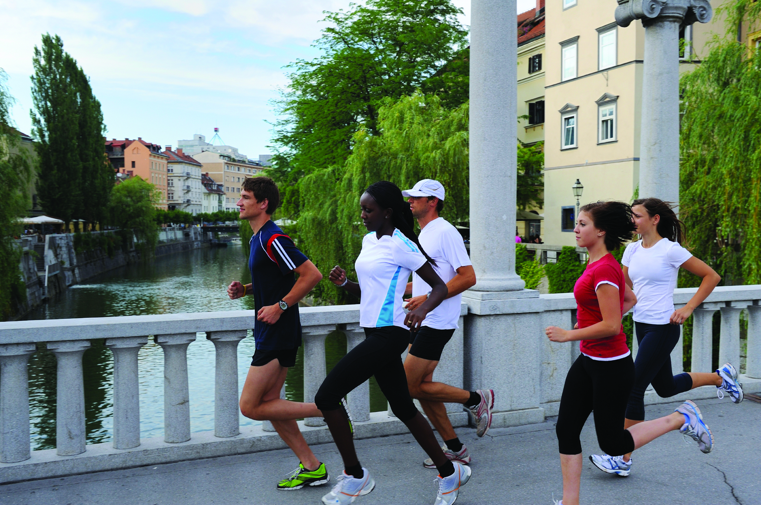
Physical Activity
Why is it important?
Regular physical activity can reduce:
Coronary heart disease
Strokes
Type 2 diabetes
Musculoskeletal disorders
Mental illness
Some cancers.
Notes:
The information conveyed in the following slides is drawn from Pharmacy Link publications:
http://www.pharmacymeetspublichealth.org.uk/publichealthresources.html
You may not wwant to use all of these slides but the slidews are designed to give staff core information on aspects of health and wellbeing. These should be taliored accordingly. There may also be opportunity to generate discussion from staff on suggestions they might make.
Inactivity is a problem in both adults and children as there is a clear link between physical inactivity and ill health - however, despite the evidence, only 40% of men and 28% of women are sufficiently active to gain any general health benefits. The remainder fail to meet the Chief Medical Officer’s recommendations for physical activity (DoH 2004 At least live a week, evidence on the impact of physical activity and its relationship to health).
Recommendations for physical activity:
Adults should be moderately active for a minimum of 150 minutes on 5 (or more) days of the week.
Children should be moderately active for a minimum of one hour every day.
A person who is doing moderate intensity activity will feel:
• An increase in breathing rate.
• An increase in heart rate, to the level where the pulse can be felt.
• A feeling of increased warmth, possibly accompanied by sweating.
It is best to build-up physical activity gradually to the recommended level. Advising people to gradually become more active in their daily lives is vital to reduce any risks and optimise the benefits. People should be advised to avoid sudden vigorous physical activity if they are not used to it, and always warm-up, warm-down and stretch after any physical activity that is moderately intensive. There will also be occasions when you will need to advise people to consult their GP or other healthcare professional before they take part in physical activity; for example, people with long-term conditions, people with existing musculoskeletal disease and/or those who are taking medicines which may affect blood pressure.

Slide 3
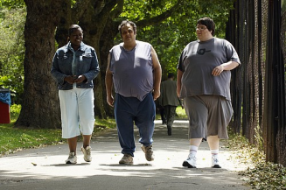
Physical Activity
Suggestions you could make:
Take the stairs instead of the lift or escalator
Get off the bus or train one stop earlier and walk the rest of the way
Walk to the shops instead of taking the car
Take a walk at lunch time
Take up an active hobby such as cycling or walking
Jobs around the house e.g. gardening and DIY.

Slide 4
Alcohol
Why is it important?
Drinking too much alcohol increases the risk of:
Serious liver disease
Stomach and pancreas disorders
Anxiety and depression
Accidents
Cancers (mouth, liver, colon and breast)
Muscle and heart disease.
Notes:
Problems arising from alcohol misuse have risen steeply over the past 10 years and between 15,000 and 22,000 people in the UK die every year from stroke, cancer, liver disease, accidental death and suicide linked to alcohol. In the same period alcohol related admissions to hospital have risen by 80% and alcoholic liver disease has more than doubled.
Individuals vary in how they process alcohol, for example by gender and body weight, but the general recommendations for drinking alcohol are:
• Men – should not regularly drink more than 3-4 units a day.
• Women – should not regularly drink more than 2-3 units a day. Pregnant women, or women trying to
become pregnant, should be advised to avoid alcohol altogether. However if they choose to drink, then advise
them to drink no more than 1-2 units once or twice a week, and avoid getting drunk

Slide 5
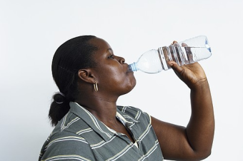
Alcohol
Suggestions you could make:
Don’t binge drink
Consider drinking a non-alcoholic drink to quench your thirst before having alcohol
Pace yourself – set a limit and stick to it
Try to eat when you drink as you’ll drink less
Reduce the number of days when you drink more than 1-2 units
Go out to the pub or club later in the evening
Resist pressures to drink more.
Notes:
Ask the group for any other suggestions they may have.

Slide 6
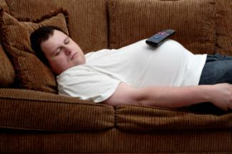
Mental wellbeing
Why is it important?
Mental health problems can cause:
Panic attacks
Loss of interest in social activities
Feelings of sadness or loneliness
Low self esteem or persistent guilt
Heavy or frequent alcohol consumption
Smoking excessively to relieve stress
Difficulty in sleeping.
Notes:
This is clearly not an exhaustive list and symptoms can be highly variable between individuals and in the same individual over time.
All mental health disorders can seriously affect a person’s physical health as well as their ability to engage with social networks and employment opportunities.
Some indicators of more serious illness:
• Hallucinations, hearing voices or strange conversations.
• Fear of persecution or threats of violence.
• Suicidal thoughts or attempts.
• Signs of recent self-harm, e.g. injuries on forearms.

Slide 7
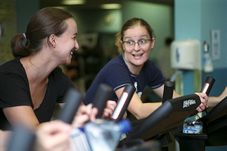
Mental Wellbeing
Suggestions you could make:
Keep active (ideally 30 minutes exercise a day)
Eat healthily do not smoke and drink alcohol in moderation
Enjoy nature (grow plants or have a pet)
Keep in touch with friends
Accept the person you are and avoid harmful emotions
Do something creative and learn new skills
Talk about your feelings.
Notes:
Ask the group for any other suggestions they may have.
Five daily habits for mental wellbeing:
• Look after your body – keep physically active, eat healthily, do not smoke and drink alcohol in moderation.
• Engage with nature – walk in a park, grow a plant, stroke a pet.
• Ensure positive social contacts – talk with someone you like, smile.
• Limit harmful emotions – acknowledge them and let them go, don’t harm others with your frustrations
• Reflect and learn – reflect on problems and try to learn something new every day.

Slide 8
Smoking
Why is it important?
Smoking can cause a range of illness, but the most serious are:
Cancers – especially lung cancer but also of the bladder, kidney, stomach and pancreas
Respiratory disease – especially lung disease and pneumonia
Circulatory disease – especially heart disease (including strokes and heart attacks)
Digestive disease – especially stomach or duodenal ulcers.
Notes:
Tobacco smoking is the main avoidable cause of premature death in England and is responsible for more than 80,000 deaths per year amongst adults aged 35 and over.
Smoking also puts other people at risk if they inhale the smoke regularly. Exposure to second-hand smoke is linked to strokes, respiratory problems (such as asthma attacks) and infections – especially ear and chest infections in children, and also cot death.
In addition, smoking is responsible for over 3000 house fires a year in the UK, typically resulting in around 100 deaths (Dept of Communities and Local Development, Fire statistics 2007).

Slide 9
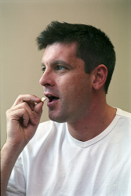
Smoking
Suggestions you could make:
Contact a stop smoking service
Use stop smoking medicines
Avoid situations which you associate with smoking
Gain support from friends and family
Undertake activities
Take your favourite clothes to the cleaners to prepare for their new smoke free life.
Notes:
Ask the group for any other suggestions they may have.
All staff have a major role to play in helping reduce the impact of tobacco on health. Their main contribution will be through identifying smokers who want to stop and referring them to sources of support - principally the NHS Stop Smoking Services.

Slide 10
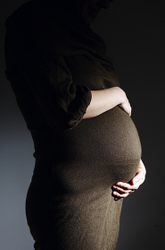
Sexual Health
Why is it important?
A healthy sex life is an important part of a persons wellbeing. The consequences of poor sexual health include:
Unintended pregnancy
Sexually transmitted infections
Low self esteem, anxiety or depression
Passing infections on to others
Relationship problems.
Notes:
Whilst sexual activity has many positive aspects, the consequences of poor sexual health may be serious and have long-lasting effects on a person’s physical and mental wellbeing.

Slide 11
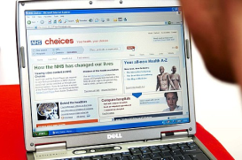
Sexual Health
Suggestions you could make:
Hugging and kissing can be as rewarding as sex
Sex should be fun and not harmful to anyone
Intimacy results from awareness of your partners needs as well as your own
Discuss any problems away from the bedroom
Ask for professional advice if necessary or seek advice from the NHS Choices website www.nhs.uk
Be honest about what you want from your partner.
Notes:
Ask for any suggestions

Slide 12
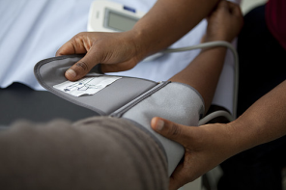
Healthy Eating & Weight Management
Why is it important?
Being overweight can seriously affect a persons health and may result in the following conditions and diseases:
Type 2 diabetes
High blood pressure
Cardiovascular disease
Cancers
Osteoarthritis, gallstones, pregnancy complications sleeping problems and changes in liver function
Decreased life expectancy.
Notes:
Being overweight is having a BMI between 25 and 30kg/m2, being obese is having a BMI of 30kg/m2 or more.
Waist measurement can also provide a good guide to a person’s health risk (particularly cardiovascular disease,
diabetes and stroke). #
In general:
• A healthy waist measurement for an average adult male is less than 37 inches (94 cm). If their waist circumference is 40 inches (102 cm) or more, even at a healthy weight (BMI 18.5 – 25 kg/m2) they are at increased risk.
• A healthy waist measurement for an average adult female is less than 32 inches (80 cm). If their waist circumference is 35 inches (88 cm) or more, even at a healthy weight (BMI 18.5 – 25 kg/m2) they are at increased risk.
Taking 30 minutes activity on 5 or more days of the week will have general health benefits and improve fitness.

Slide 13
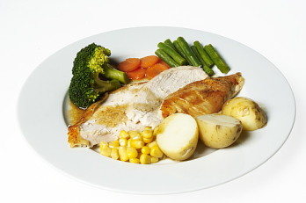
Healthy Eating & Weight Management
Suggestions you could make:
Eat a balanced diet
Eat at least five portions of fruit and vegetables
Check for fat and sugar content on food labels
Choose lean cuts of meat, trim off the fat
Boil, steam, grill or poach rather than fry and roast
Stick to three meals at the same time each day
Choose low sugar food and drink
Cut down on alcohol.

