Slide 1

Falls and Fracture Prevention Training

Slide 2
What is a Fall?
A fall is an unintentional event whereby an individual comes to rest on the ground or another lower level with or without a loss of consciousness.

Slide 3
Which falls need to be reported?
All incidents should be reported. It is about learning and preventing further incidents, NOT blame.

Slide 4
Some facts about falls
1 in 3 over 65 year olds will fall at least once each year
1 in 2 over 80 year olds will fall at least once each year.
Falls are the leading cause of injury related deaths in 75 year olds.
Falls are a major reason for elderly admissions to hospital and hospital attendances.
Falls are the major reason for ambulance call outs to the elderly.
Falls are a major factor in admissions to long term care.
The annual cost of falls is £2.3 billion

Slide 5

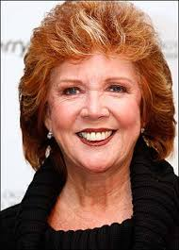
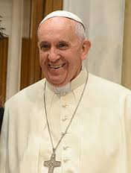
The Human Cost of Falls
Loss of confidence and fear of further falls
Social isolation and reluctance to leave the home.
Reduced independence
Permanent physical disability
Death – 1/3 of people sustaining a hip fracture will die within 1 year

Slide 6
Older people are bound to fall?
Anyone can fall but falls are an increasing risk as you get older.
Falling is not inevitable.
There is plenty that can be done to prevent them or to reduce the harm that might result from falling.

Slide 7
Risk Factors Associated with
Falls
Toilet and continence
Environment
Footwear
Hearing and vision
Cognitive impairment
Medication
Medical conditions

Slide 8
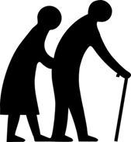
Age
1 in 3 people over the age of 65 will fall at least once each year.
1 in 2 people over the age of 80 will fall at least once each year
Many people are living into their 90’s.

Slide 9
Exercise
Appropriate exercise is important to strengthen bone and muscle and to improve balance and co-ordination.

Slide 10

Previous Falls
1 or more previous falls increases the risk of further in the future.
Fear of falling is a significant problem.
As estimated 75% of falls in home are not reported.

Slide 11
Postural Hypotension
Postural hypotension is a drop in blood pressure when standing.
This can be associated with some drugs, prolonged bed rest or standing up suddenly.

Slide 12
Medical Conditions
Parkinson’s disease
Diabetes
Heart Failure
Arthritis
Stroke

Slide 13

Medication
Older people often take a number of medications. Many of these can increase the risk of falls e.g. hypertensive medications, analgesics, anti-depressants and diuretics.
All medications should be reviewed by a GP or pharmacist at least once every 6 months.

Slide 14
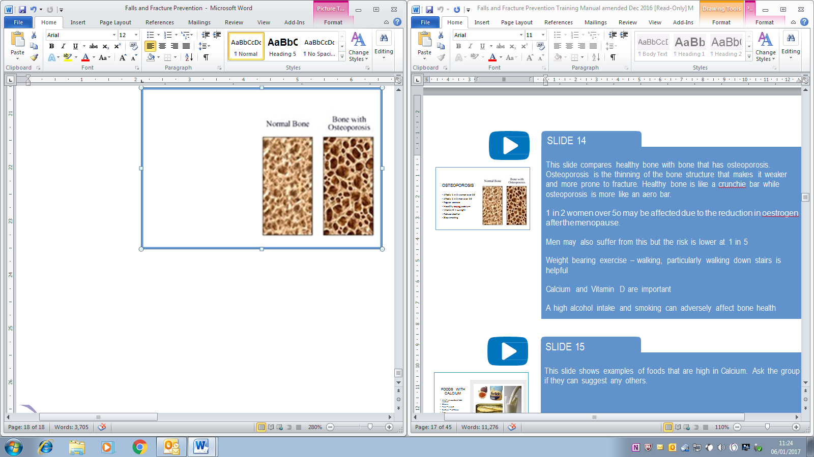
Osteoporosis

Slide 15
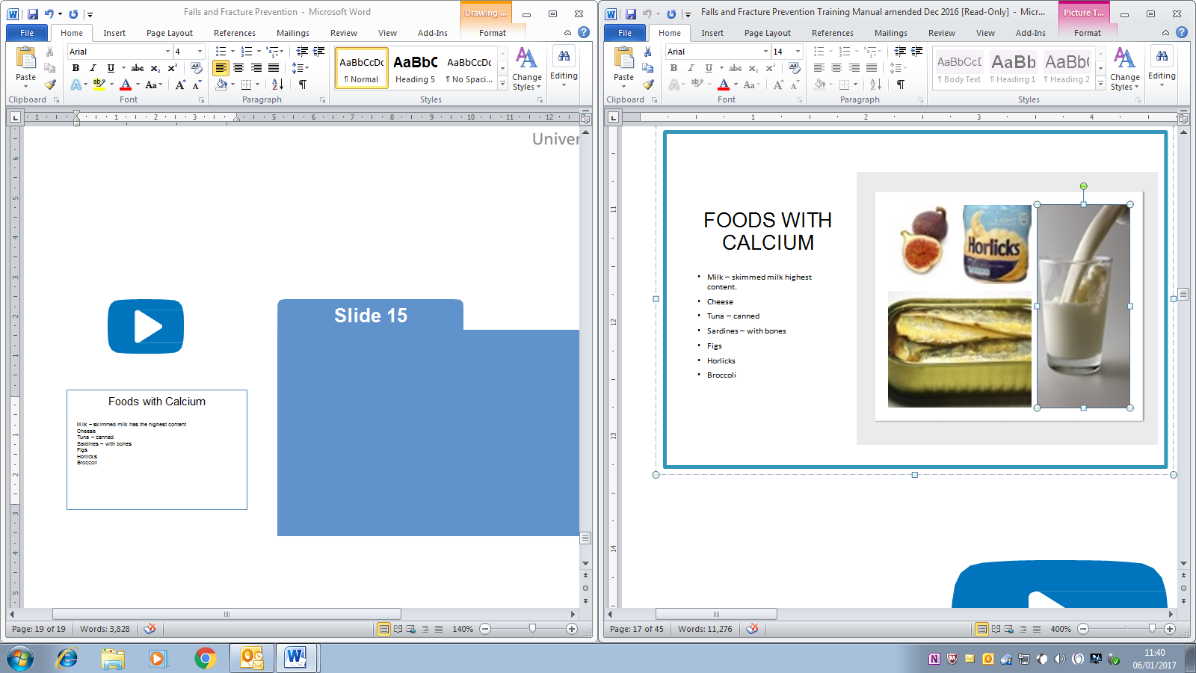
Foods with Calcium
Milk – skimmed milk has the highest content
Cheese
Tuna – canned
Sardines – with bones
Figs
Horlicks
Broccoli

Slide 16

Vitamin D
Best source of Vitamin D is sunlight.
20 minutes of sun exposure is enough.

Slide 17
Hydration
Elderly people have a reduced feeling of thirst and therefore are likely to become dehydrated more quickly.

Slide 18
Confusion and Cognitive
Impairment
Dementia
Delirium

Slide 19

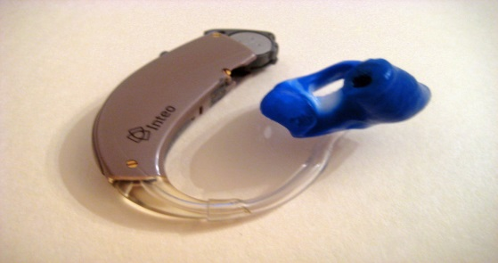
Hearing and Vision
Eyesight may be affected for many reasons.
Estimated 30% of visual impairment over the age of 75 may be due to wearing the wrong glasses or none at all.
Regular eyesight testing.
Hearing problems and hearing loss may affect balance.

Slide 20

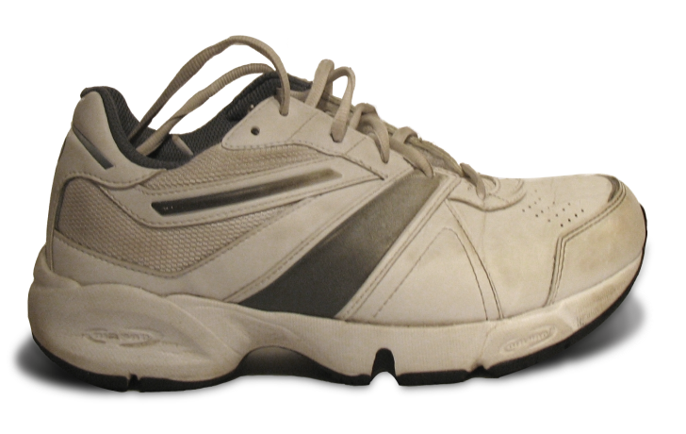
Appropriate Footwear
Is footwear safe and appropriate?

Slide 21
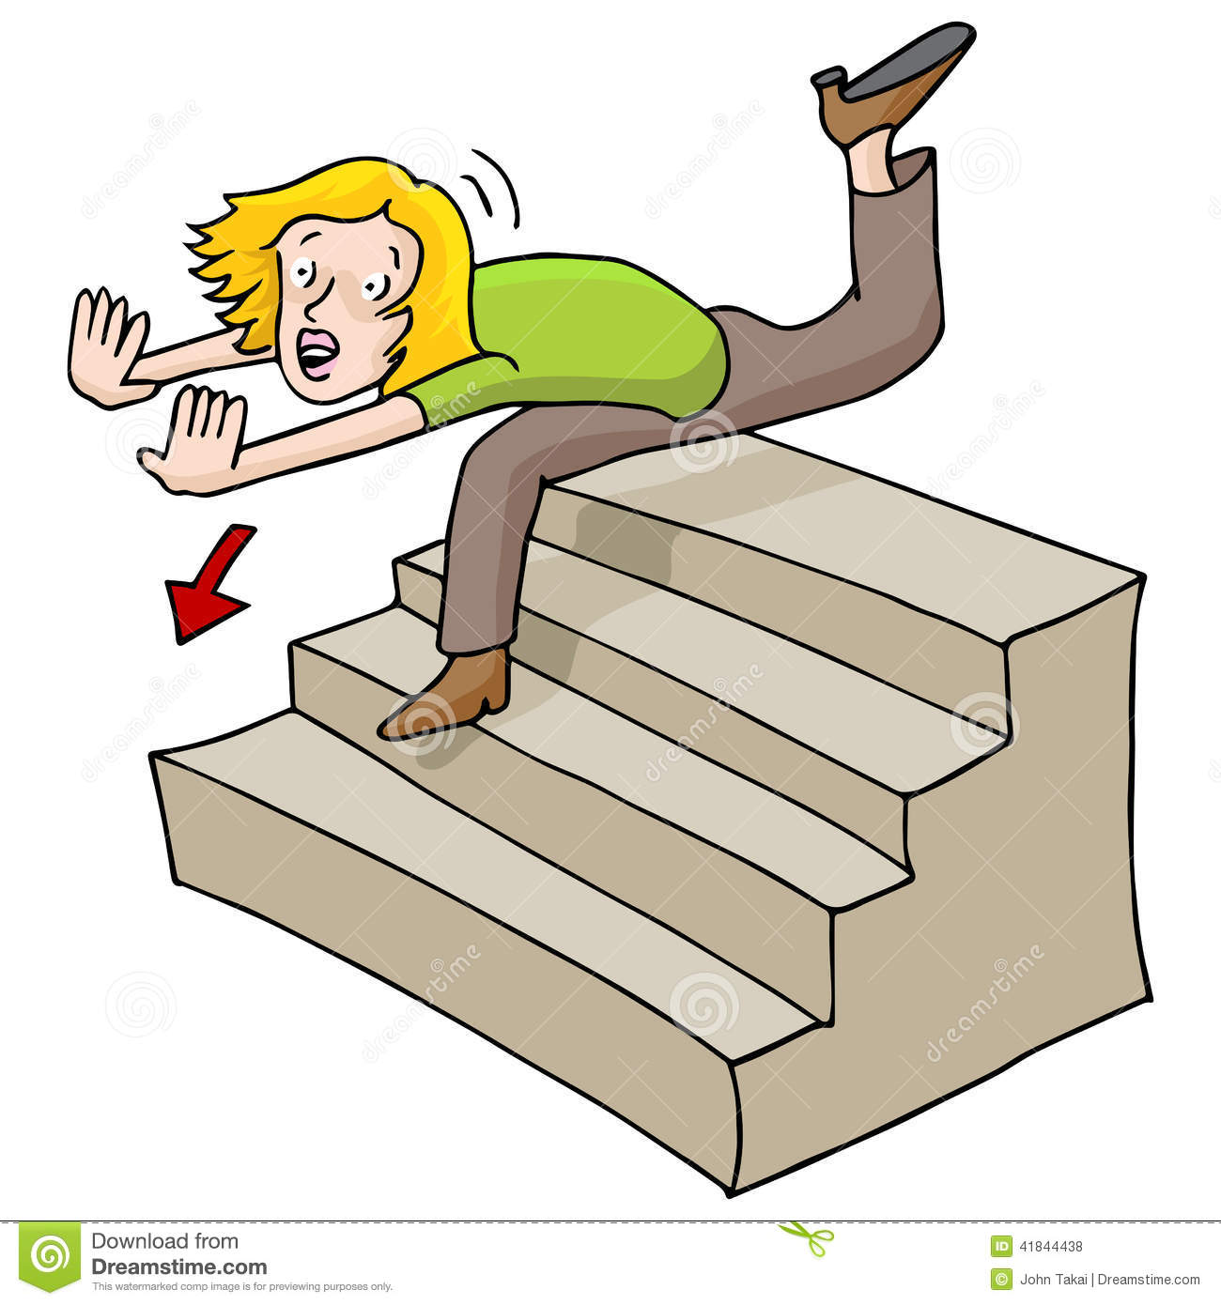
Environment – Tripping Hazards

Slide 22
Toilet and Continence
Many falls occur as a result of trying to reach the toilet or wanting to go to the toilet.
Urge incontinence.
Urine infection.
Constipation.
Bowel disorders.

Slide 23

Falls
What to do if someone falls

Slide 24
Falls
Remain calm and reassure the person who has fallen.
Call for help.
Check if the person is conscious – if not place in the recovery position and call 999.
If the person is conscious – check for obvious signs of injury. Ask if they have hit their head. Assess general conditional and presence of pain. Move the person onto a more comfortable place when safe to do so.
Continue to monitor for signs of injury that may develop later.
Inform the GP and family.
Record events accurately.
ALWAYS FOLLOW THE LOCAL POLICY AND PROCEDURES.

Slide 25

What will you do differently?

